Slide 1

Harnessing High Frequency Data To Inform Development and Humanitarian Interventions
Christopher B. Barrett
Cornell University
Public lecture at
China Center for Agricultural Policy, Peking University
October 29, 2025

Slide 2
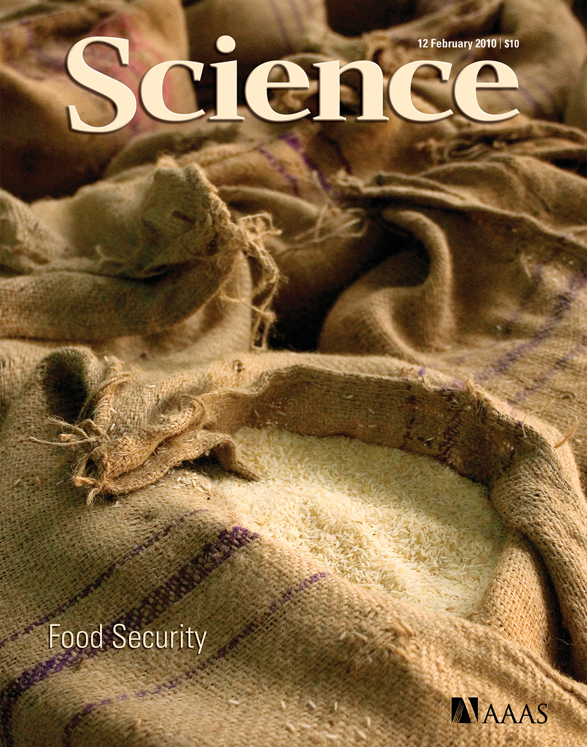
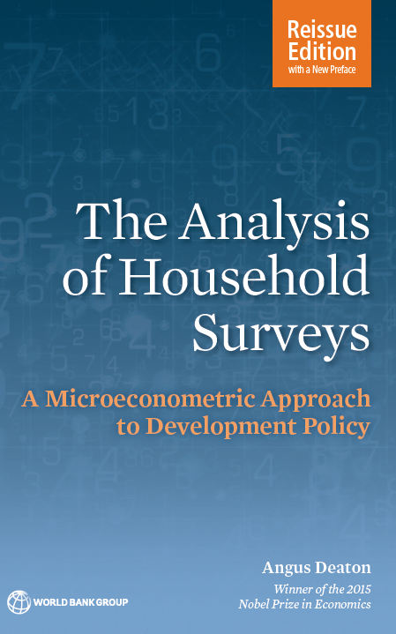
Why national survey data?
Statistically representative observational data essential for accurate descriptive/predictive analysis. Often useful for inferential analysis.
“To direct scarce resources to where they can do the greatest good, actions must be guided by reliable information … Measurement drives diagnosis and response. ”
– Barrett (Science 2010)
That is the purpose of censuses and surveys that offer statistically representative samples of a defineable population: LSMS, DHS, MICS, etc. “With improved measurement came improved analysis.”
– Angus Deaton 1997 (and 2018)

Slide 3
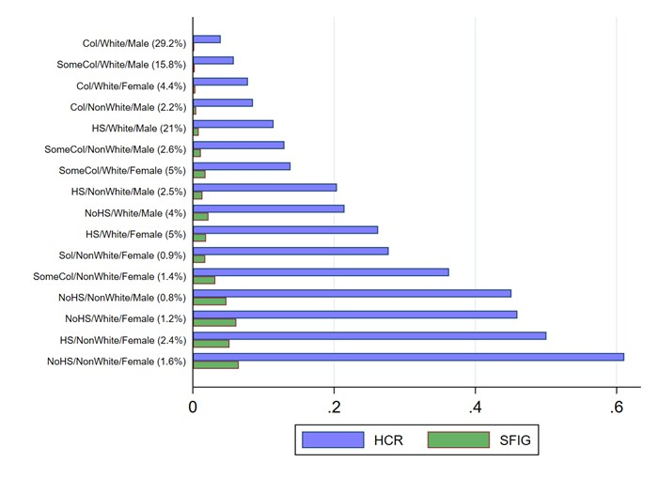
Why high-frequency longitudinal (HFL) national survey data?
Living standards are dynamic. A solid understanding of dynamic living standards requires HFL data. 4 big reasons:
Differentiating chronic vs. transitory state (in poverty/food insecurity/ill health/etc.) matters fundamentally to policy design and evaluation.
Source: Lee et al. AJAE (2024):

Slide 4
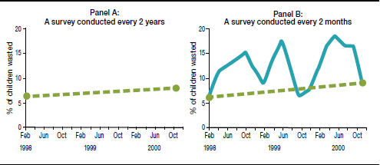
Why high-frequency longitudinal (HFL) national survey data?
Child wasting in Bangladesh
2. Seasonality important (esp. in rural areas). Surveys every few years either miss seasonality or create seasonal mismatch issues in intertemporal comparison that confound inference.
Source: Barrett & Headey (IFPRI 2014) using data from Bloem et al. (HKI 2003)

Slide 5
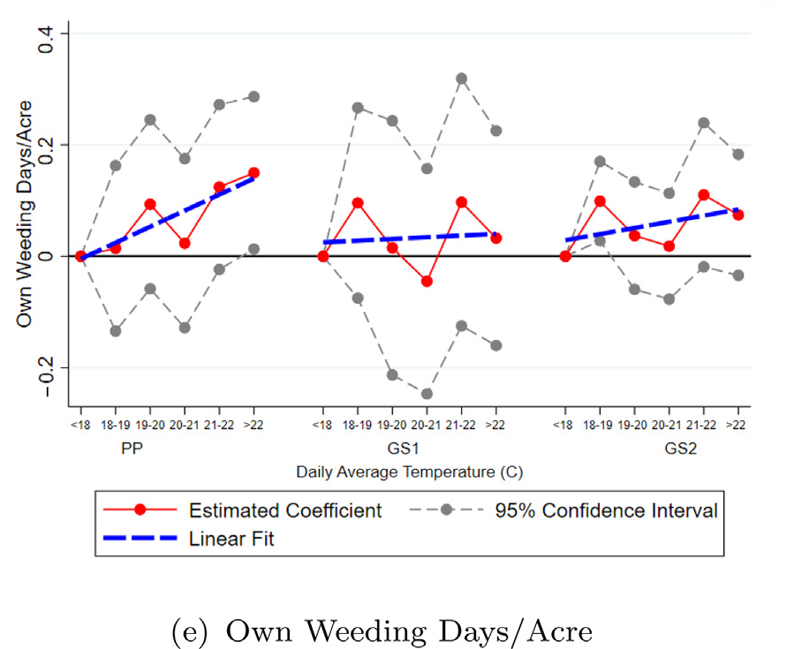
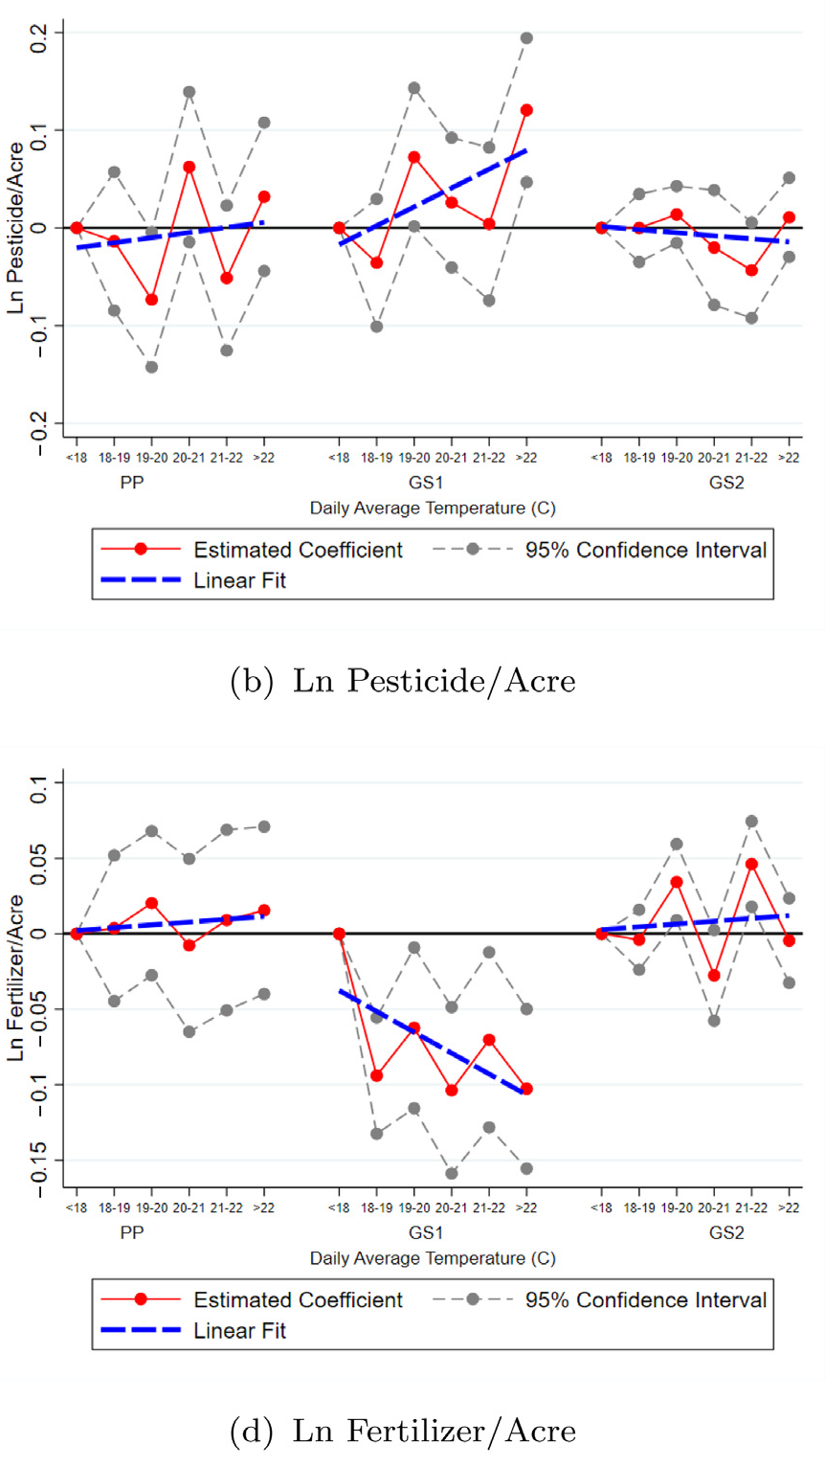
Why high-frequency longitudinal (HFL) national survey data?
Kenyan maize farmers’ response to warming temperatures
3. Dynamics of risk and uncertainty. Hard to understand behavior or well-being –or to responsibly inform policy design and evaluation – w/o considering risk.
Defensive actions/investments
- Moments beyond the mean matter to behavior and well-being (e.g., Ethiopian herders’ subjective well-being and IBLI).
Source: Jagnani et al. EJ (2021):

Slide 6
Why high-frequency longitudinal (HFL) national survey data?
4. Improved inference about what causes change in living standards.
FE estimators –true intertemporal change; time invariant unobservables.
Improve external validity – Rosenzweig & Udry (REStudies 2020)
Improve internal validity amid non-random post-treatment shock exposure.
DGPs typically nonstationary. Hard to forecast from old data – Constenla-Villoslada et al. (PNAS 2025)

Slide 7
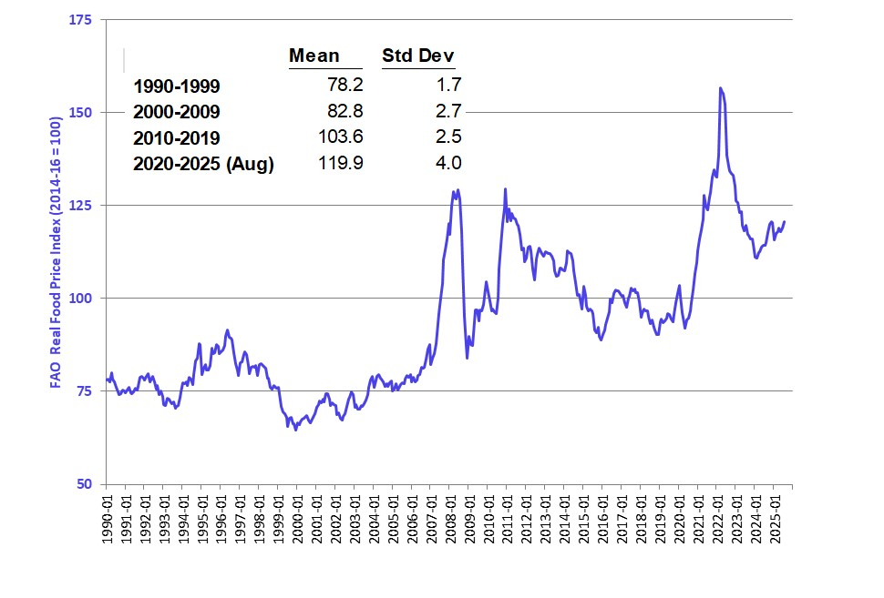
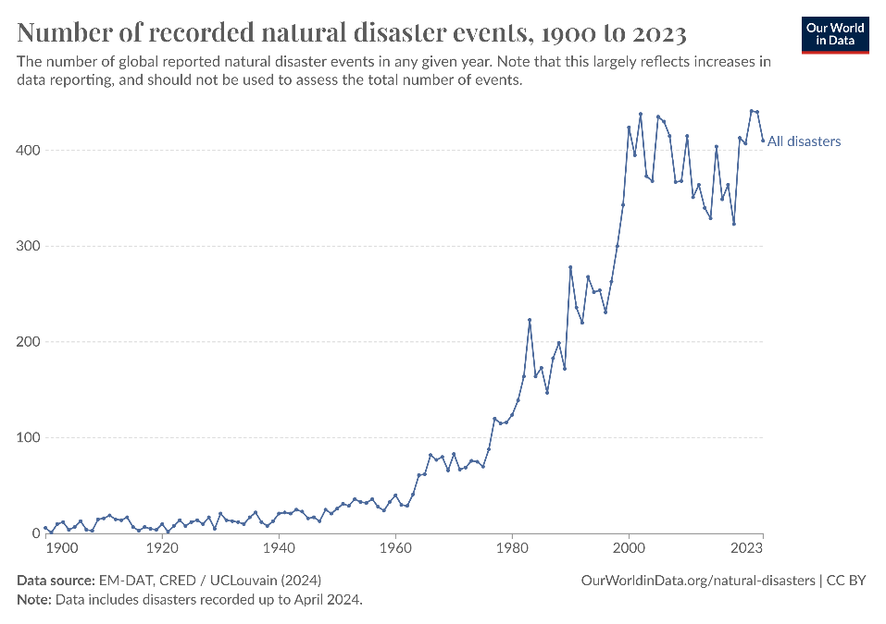
Polycrisis era
HFL data esp. important amid polycrisis. Rising multidimensional risks: weather, conflict, prices, pandemics, etc. Solid inference around effective interventions crucial. Must parse chronic/seasonal/ transitory effects of shocks.
Distinction b/n s-run humanitarian and longer-run development interventions is increasingly blurred, esp. in low-income settings.
Hence enthusiasm for ‘resilience’ = shock-proofing continuous improvement in living standards.

Slide 8



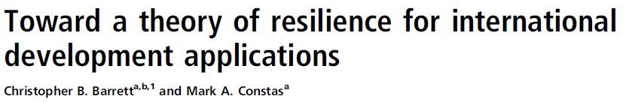
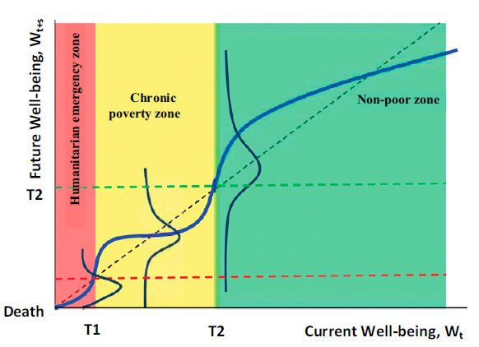
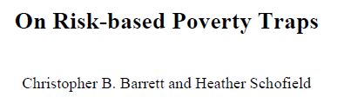
Polycrisis, poverty traps, and resilience
Poverty traps increasingly understood as arising due to catastrophic risk exposure and/or the experience of catastrophic shocks. Reasonable theory exists, rooting resilience in living standards.
poverty line

Slide 9
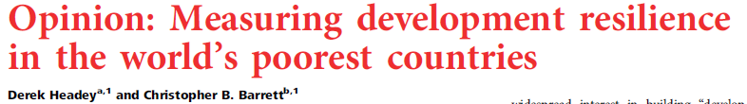
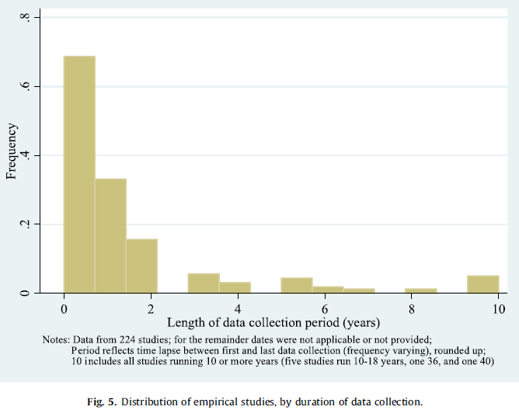
Resilience measurement
HFL survey data especially important for studying resilience.
Yet very scarce. Scoping review of ‘resilience’ studies 2008-2020 found just 16% used panel data at all, much less HF! (Barrett et al. WD 2021)
“our empirical understanding of development resilience in developing countries remains remarkably limited, primarily because of data shortcomings. … [The world needs] a multicountry system of high-frequency, long-term sentinel sites in the world’s most vulnerable (and largely rural) regions. … In an increasingly volatile world, good data are essential. Such data will help the global community build development resilience and eliminate hunger, extreme poverty, and vulnerability in the generation ahead.”

Slide 10
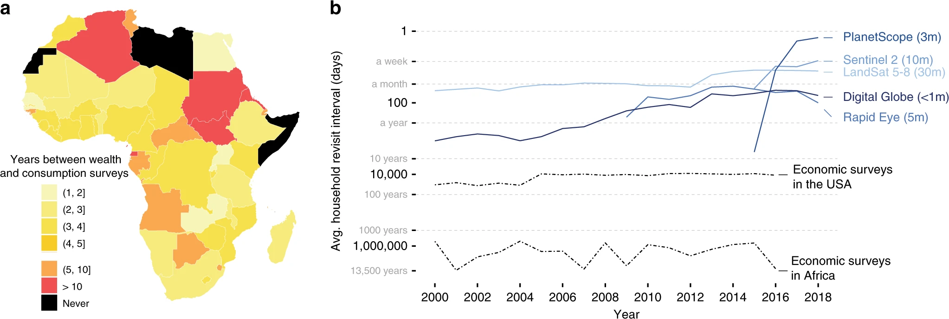
Appeal of HFL Geospatial Data and Machine Learning
The dearth of HFL socioeconomic survey data motivates enthusiasm for HFL geospatial data and ML algorithms to generate nowcasts/forecasts:
“ a given African household will appear in a household well-being survey less than once every 1000 years” – Yeh et al. (Nature Communications 2020)

Slide 11
Benefits/Limits to Machine Learning
But HFL EO data complement, not substitute, for HFL SE data. Opportunities arising from ML and VHR/HF geospatial data reinforce need for HFL SE data.
ML models need lots of good, reasonably current training data, ideally HFL SE data. Nonstationarity is a fundamental challenge, even to nowcasting. (Browne et al. PLoS ONE 2021; Constenla et al. PNAS 2025; Tennant et al. WB PRWP 2025).
Prone to atheoretic modeling (McBride et al. AEPP 2022)
Frequent, large bias – focus on OOS predictive skill overall. Misses significant spatial/livelihood heterogeneity, esp. related to unobservables and non-classical measurement error. (Ru et al. in review; Tennant et al. PNAS 2025)
Reproducibility harder than conventional econometric/statistical work.
Often too technical and high-cost for operational agencies.

Slide 12
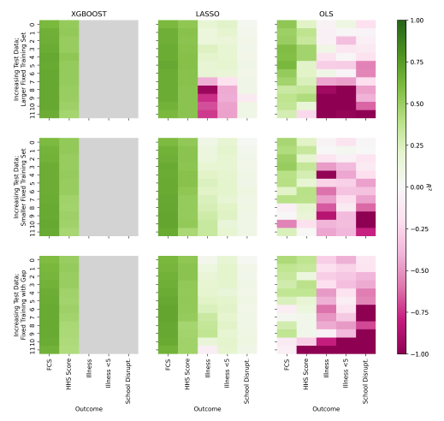
Benefits/Limits to Machine Learning
Machine learning is indeed very promising, esp. for data fusion.
(Yeh et al. NC 2020; McBride et al. AEPP 2022; Gualavisi & Newhouse WBER 2024; Newhouse CSAB 2024, Constenla-Villoslada et al. PNAS 2025; Tennant et al. WBPRWP 2025)
Example 1: Nowcasting in rural Malawi
Fine spatial (ADM3/4) scale for early warning, targeting, and/or evaluation (Tennant et al. WB PRWP 2025).
EO data on their own not very predictive.
When combined with recent survey data, can nowcast/forecast FCS, HHS well.

Slide 13
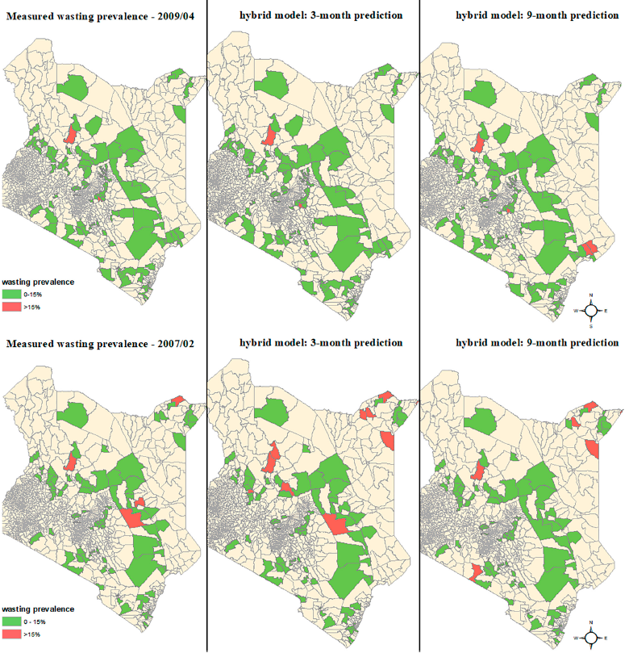
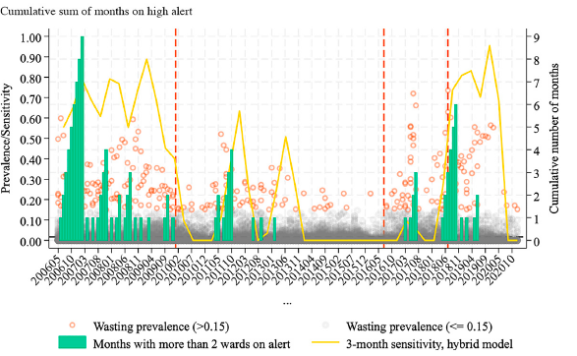
Benefits/Limits to Machine Learning
Example 2: Constenla-Villoslada et al. (PNAS 2025) show that ML models trained on monthly MUAC data predict well U5 GAM well out to ~6 months. Variable importance varies a LOT over time. Models work best when most needed.

Slide 14
What role for HFL survey data in polycrisis era?
Rapid response ≠ researchers’ comparative advantage. We must improve our ability to respond to sudden changes.
HFL SE survey data can not only:
improve ability to describe dynamics and risk
do better inference
add value to HFL geospatial data and ML
HFL SE survey data can also enable analytical tasks that researchers undersupply currently.

Slide 15

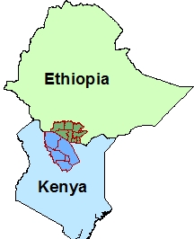
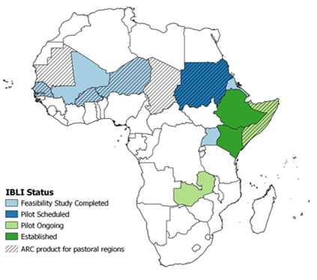
What role for HFL survey data in polycrisis era?
Can design interventions to build resilience.
Example: index-based livestock insurance (IBLI)
HFL survey data enabled original IBLI design and piloting. (Chantarat et al. JRI 2013)
Enabled quasi-experimental comparison of IBLI vs. cash transfers. (Jensen et al. JDE 2017)
End result: IBLI scaled from pilot in small parts of 2 countries to broader use in 4 (and growing: Kenya Livestock Insurance Program, DRIVE). ~600K people covered to date, expected/targeted >1.5M by end-2025.
Pilot areas

Slide 16
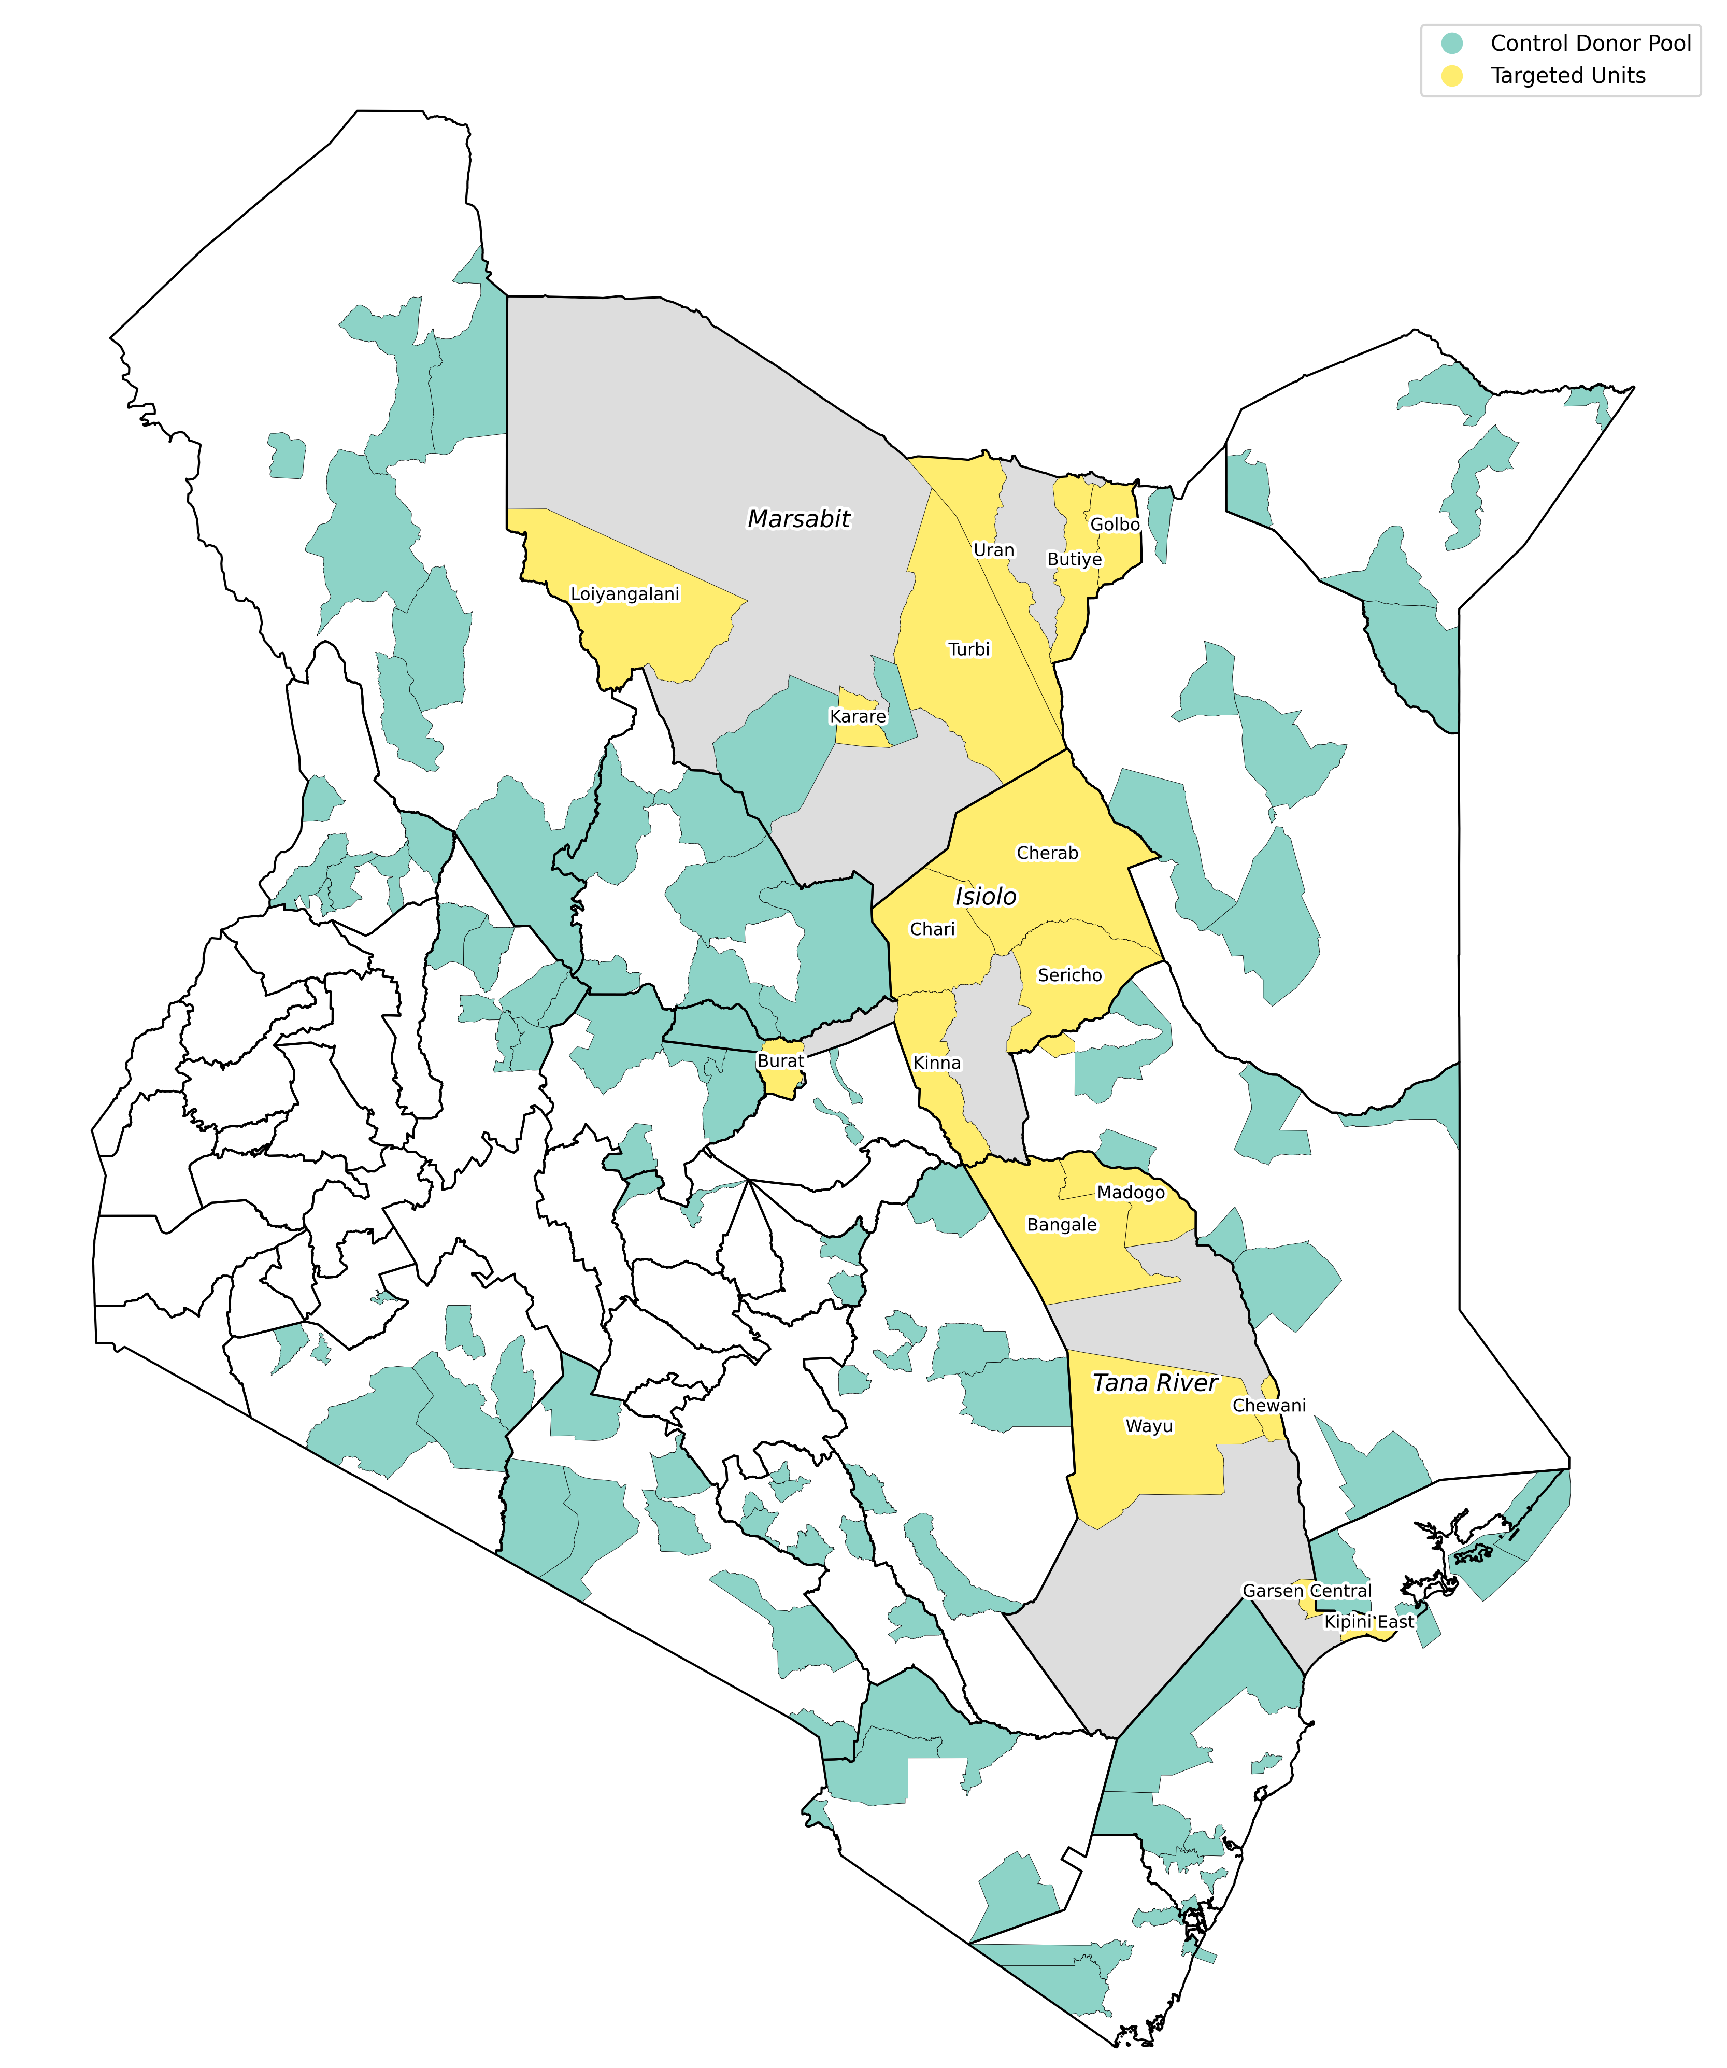
What role for HFL survey data in polycrisis era?
Example 2: anticipatory transfers based on child GAM forecasts
Most empirical economic analysis inherently backward looking. Policy advice intrinsically forward-looking.
HFL survey data allow for (i) rapid updating, (ii) nowcasting/forecasting for early warning and geographic targeting. Accommodates shocks, nonstationarity in key series.
Kenya NDMA set to launch anticipatory mobile cash transfers based on Constenla-Villoslada et al. forecasting tool. Evaluate impacts using synthetic control methods. Stay tuned! ☺

Slide 17
Summary
In polycrisis era, HFL survey data are more valuable than ever. Help answer policymakers’ questions in face of growing risk and shocks:
What gains from emergency preparedness? Behavioral responses to risk/shocks measured right. (Rockmore work on conflict in Uganda)
What benefits from response to shocks? Transitory vs. seasonal vs. chronic and possibility of poverty traps. Inference using ‘within’ variation.
- Which tool(s) to use? More A/B testing, less H₀=0 testing. Test under varied states of nature.
Where and when to respond? Nowcasting/forecasting maps
How to customize bundled responses? Sufficient variation in sites to identify heterogeneous and interaction effects.
Researchers have lots to do to help build resilience to polycrisis!

Slide 18
Thank you
Thank you for your time and interest!
Follow-up questions/comments?
Email me: cbb2@cornell.edu

